Slide 1
Mini Project Data Engineering (Northwind)
DSLS 2023
Silvia Astri Rahmaningrum

Slide 2
Preview Northwind Database
The Northwind database contains sales data for a fictitious company called Northwind Traders, which imports and exports specialty foods from around the world.

Slide 3
01
Sales Analysis

Slide 4
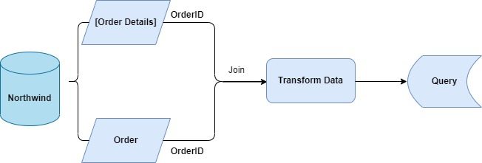
The sales department want to find insight of the sales during July 1996 – May 1998
SELECT
YEAR(o.OrderDate) AS Year,
MONTH(o.OrderDate) AS Month,
COUNT(DISTINCT d.OrderID) AS Sum_of_Customer,
SUM(d.Quantity) AS Sum_of_Quantity,
SUM(ROUND(d.UnitPrice * d.Quantity * (1-d.Discount),2)) AS Sales
FROM [Order Details] AS d
JOIN Orders AS o ON d.OrderID = o.OrderID
GROUP BY YEAR(o.OrderDate), MONTH(o.OrderDate)
ORDER BY YEAR(o.OrderDate), MONTH(o.OrderDate)

Slide 5
Year | Month | Sum_of_Customer | Sum_of_Quantity | Sales
1996 | 7 | 22 | 1462 | 27861.9
1996 | 8 | 25 | 1322 | 25485.28
1996 | 9 | 23 | 1124 | 26381.4
1996 | 10 | 26 | 1738 | 37515.73
1996 | 11 | 25 | 1735 | 45600.04
1996 | 12 | 31 | 2200 | 45239.63
1997 | 1 | 33 | 2401 | 61258.08
1997 | 2 | 29 | 2132 | 38483.63
1997 | 3 | 30 | 1770 | 38547.23
1997 | 4 | 31 | 1912 | 53032.95
1997 | 5 | 32 | 2164 | 53781.29
1997 | 6 | 30 | 1635 | 36362.81
1997 | 7 | 33 | 2054 | 51020.87
1997 | 8 | 33 | 1861 | 47287.68
1997 | 9 | 37 | 2343 | 55629.25
1997 | 10 | 38 | 2679 | 66749.24
1997 | 11 | 34 | 1856 | 43533.8
1997 | 12 | 48 | 2682 | 71398.44
1998 | 1 | 55 | 3466 | 94222.13
1998 | 2 | 54 | 3115 | 99415.29
1998 | 3 | 73 | 4065 | 104854.18
1998 | 4 | 74 | 4680 | 123798.69
1998 | 5 | 14 | 921 | 18333.64
Table Overview

Slide 6
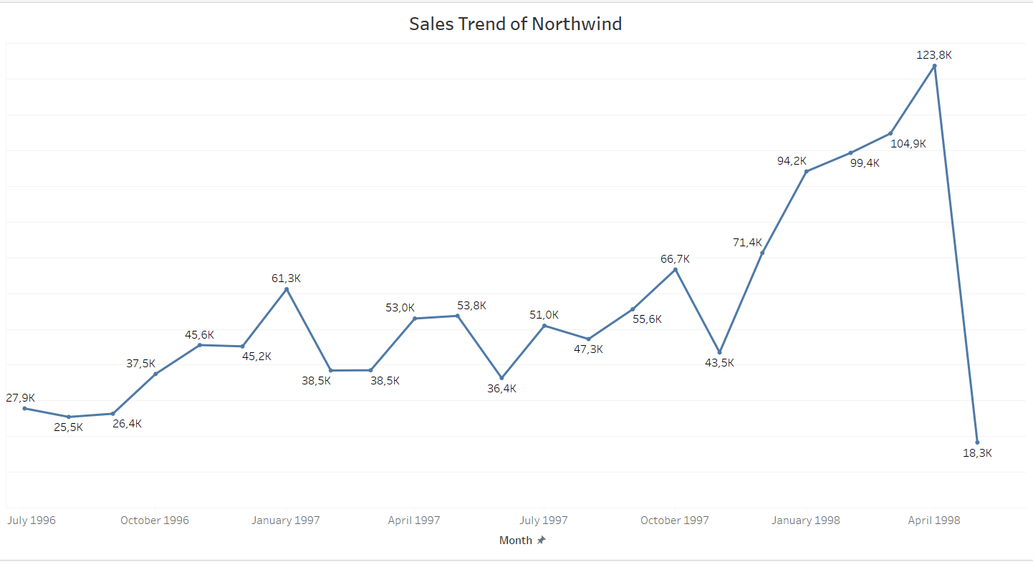
Sales trend of Northwind tends to increase from November 1997 until April 1998 up to 123.8K but in May 1998 the sales is decrease up to 18.3K

Slide 7
02
Employee Analysis

Slide 8
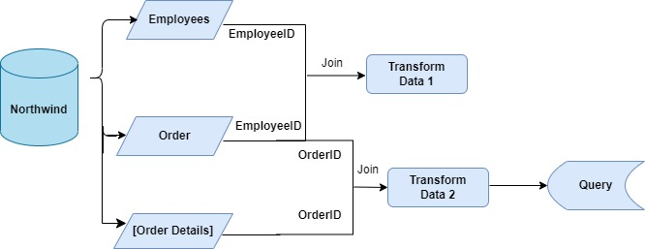
The HR team wants to know the employee name that deals with orders
WITH employee_order AS (
SELECT CONCAT(e.FirstName, ' ',e.LastName) AS employee_name,
e.Title AS employee_title,
COUNT(DISTINCT d.OrderID) AS total_orders,
SUM(ROUND(d.UnitPrice * d.Quantity * (1-d.Discount),2)) AS total_amount
FROM Employees AS e
JOIN Orders AS o ON e.EmployeeID = o.EmployeeID
JOIN [Order Details] AS d ON o.OrderID = d.OrderID
GROUP BY CONCAT(e.FirstName, ' ',e.LastName), e.Title
)
SELECT *,
100 * total_amount / (SELECT SUM(total_amount) FROM employee_order) AS '%_total_amount'
FROM employee_order
ORDER BY total_amount DESC

Slide 9
Table Overview
employee_name | employee_title | total_orders | total_amount | %_total_amount
Margaret Peacock | Sales Representative | 156 | 232890.85 | 18.40
Janet Leverling | Sales Representative | 127 | 202812.86 | 16.02
Nancy Davolio | Sales Representative | 123 | 192107.65 | 15.18
Andrew Fuller | Vice President, Sales | 96 | 166537.76 | 13.16
Laura Callahan | Inside Sales Coordinator | 104 | 126862.3 | 10.02
Robert King | Sales Representative | 72 | 124568.24 | 9.84
Anne Dodsworth | Sales Representative | 43 | 77308.08 | 6.11
Michael Suyama | Sales Representative | 67 | 73913.14 | 5.84
Steven Buchanan | Sales Manager | 42 | 68792.3 | 5.43

Slide 10
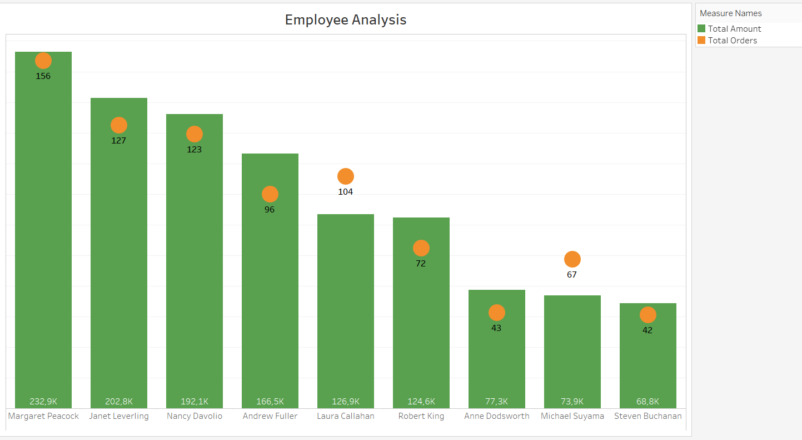
Based on the chart above, Margaret Peacock is the Most Valuable Employee who handle the most orders with a total sales 232.9K and total orders 156 for customer purchase.

Slide 11
03
Shipper Analysis

Slide 12
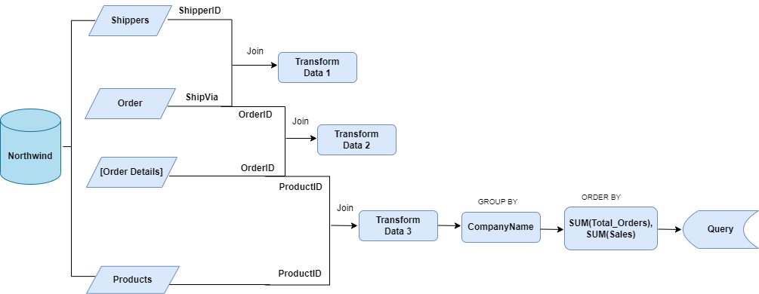
The logistics teams want to know the most orders with which shipper
WITH send_order (Month, ProductName, CompanyName, Total_Orders, Sales) AS(
SELECT MONTH(o.ShippedDate),
p.ProductName,
sh.CompanyName,
COUNT(DISTINCT o.OrderID),
SUM(d.Quantity * d.UnitPrice)
FROM orders AS o
JOIN Shippers AS sh ON o.ShipVia = sh.ShipperID
JOIN [Order Details] AS d ON o.OrderID = d.OrderID
JOIN Products AS p ON d.ProductID = p.ProductID
GROUP BY MONTH(o.ShippedDate), p.ProductName, sh.CompanyName
)
SELECT CompanyName, SUM(Total_Orders) AS Total_Orders, SUM(Sales) AS Sum_of_Sales
FROM send_order
GROUP BY CompanyName
ORDER BY SUM(Total_Orders) DESC, SUM(Sales)

Slide 13
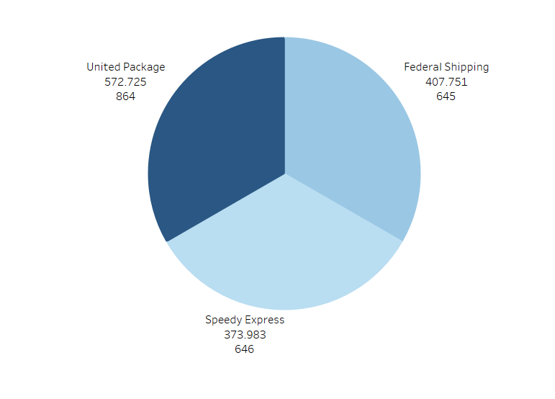
Table Overview
CompanyName | Total_Orders | Sum_of_Sales
United Package | 864 | 572724.58
Speedy Express | 646 | 373983.19
Federal Shipping | 645 | 407750.82
The shipping company name United Package is the favorite shipping by customer to shipping their order. For July 1996 – May 1998 has delivered around 864.

Slide 14
Thanks
Does anyone have any questions?
addyouremail@freepik.com
+91 620 421 838
yourcompany.com
CREDITS: This presentation template was created by Slidesgo, including icons by Flaticon and infographics & images by Freepik.
Please keep this slide for attribution

